Slide 1
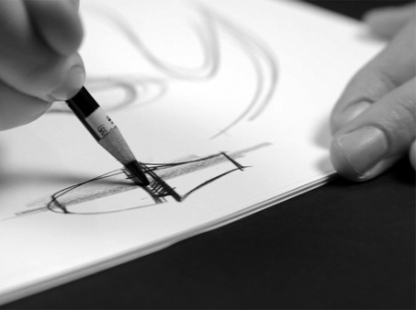
higher Design & Manufacture
Idea Generation

Slide 2


Learning intentions & success criteria
Learning Intentions
Introduction to initial idea generation.
Success Criteria
Understand the purpose of initial ideas.
Create several initial ideas for any given brief.

Slide 3
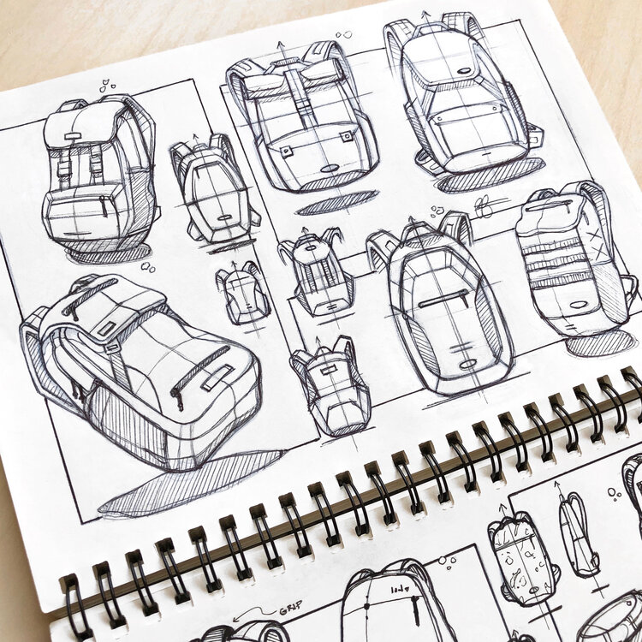
Idea generation techniques
Designers often use idea generation techniques to stimulate creative thinking.
We use a number of idea generation techniques to help us think of new and exciting designs.
Today we are focusing on
  Thought showers (Brainstorming)
  Inspiration boards (Mood/Lifestyle/Theme)
  Morphological Analysis
  Nat 5 reminders-
  Scamper (in design development PP)
  Technology transfer
  Analogy/Biomimicry
  Taking your pencil for a walk

Slide 4
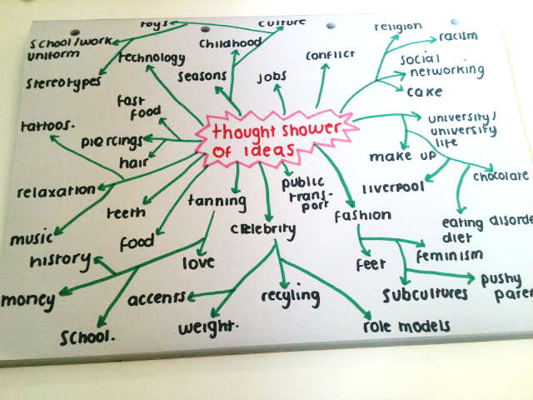
Thought shower
This is a very popular idea generation technique which can be completed as a group or on your own.
Thought showers should include any word or phrase that pops into your head when you are thinking about the chosen theme.

Slide 5

Thought shower guidelines
The Guidelines for Thought Showers are as follows:
  The problem must be defined in simple terms to encourage many solutions.
  Quantity has priority to begin with not quality.
  Think first, evaluate later.
  No idea, no matter how outrageous, should be disregarded.
  Let free thinking develop through word association.
  Combine, expand or improve previous ideas.
  Evaluate the ideas at a later stage.
  Select and list the ideas that have merit or value.

Slide 6

thought shower advantages
Creating and generating ideas this way has its Advantages:
  Helps members think and express themselves.
  Other peoples ideas can encourage a chain reaction thinking.
  A wealth of alternative suggestions can be found.
  Group members are encouraged to work and cooperate as a unit.

Slide 7
thought shower disadvantages
There can also be Disadvantages:
  Chain reaction thinking can encourage different lines of thinking being channelled into a limited number of ideas.
  One person may suggest an idea that the others latch on to.
  A wider range of ideas may not be explored because of this.
  This does not mean that Thought Showering is a bad thing, although safeguards should be taken to avoid channelling ideas into a limited line of thinking. There is a technique called “Brainwriting” that begins to take such precautions.

Slide 8

task
Brainstorming activity.
In your jotter, write down the word “NATURE” in the middle of a blank page.
Now, write down as many words or terms that pop into your head when you think of “nature.”
From each word, create additional branches to show your train of thought.

Slide 9
warm
autumn
natural
green
organic
park
leaves
grass
vegetables
twigs
wood
orange
puddles
picnic
brown
yellow
stream
Nature
cold
animals
buzz
trees
butterflies
windy
sunshine
water
mud
mushrooms
logs
breeze
toadstools
forest
bugs
pond
birds
rocks
flowers
bumble bee
bright
waterfall

Slide 10
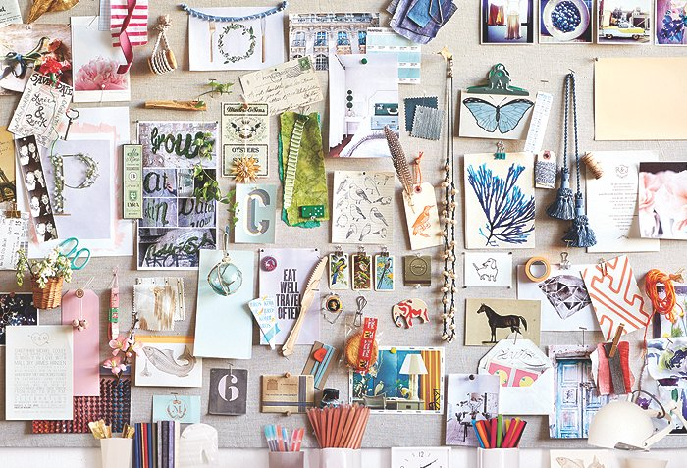
boards
An inspiration board brings together a number of images related to the theme.
There are a few types of inspiration boards we need to know about
  Mood board
  Lifestyle board
  Theme board
These boards are all very similar as they use a wide range of images to represent something to give them inspiration for shape, colour, materials etc.

Slide 11
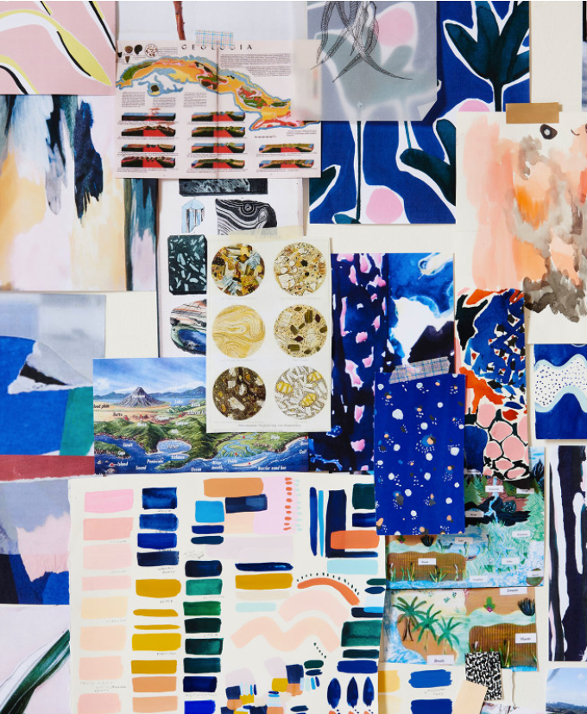
Mood boards
A range of visual images are used to create an atmosphere which reflects a chosen mood.
The mood of a product is the feeling or emotion aroused in us when we see the it.
A mood board can be personal and unique to the creator as images can trigger different emotions in different people.
Mood boards can be created by the designer, the client or the consumer.
Particular moods will appeal to different people. Colours can also be displayed in mood boards.
Moods to consider:
Stressed, Cool, Sad, Happy

Slide 12
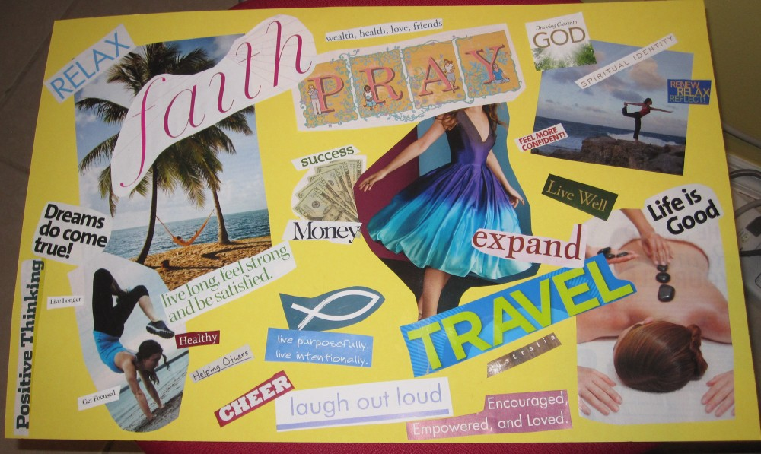
Lifestyle board
Full visual images giving a snapshot of a particular target group.
Firstly find your target market, find out as mush about them as you can. Secondly research where they go? What they wear? What they eat? and so on to create the board.
Once this has been done collect visual images of the group looking at: Music, food, houses, cars, hobbies, styles and so on. Fabrics etc. can also be used
Once your product is completed a picture of it can then be placed on each of these boards to see whether it looks out of place

Slide 13
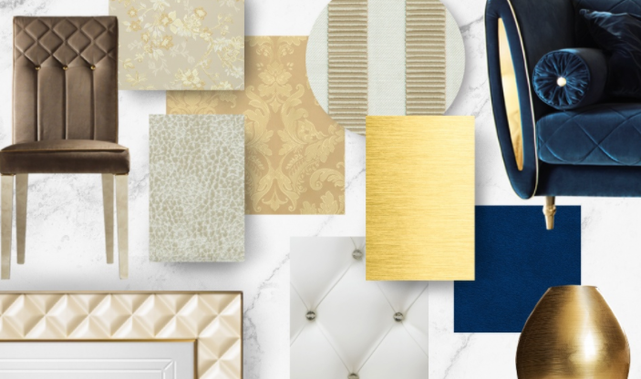
Inspiration board
A chosen theme is researched in the same way as a mood and lifestyle board.
A theme is researched and pictures are found to support this.
For example:
  Casino – Playing cards, dice, money and so on.
  Garden – grass, trees, tools, flowers and so on.

Slide 14
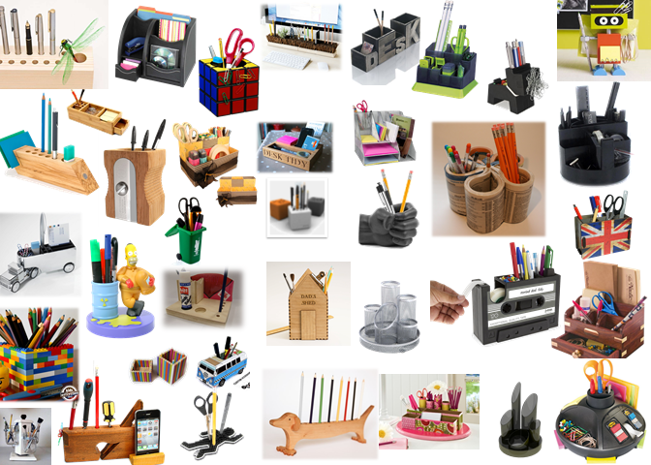
INSPIRATION BOARD – DESK ORGANISER

Slide 15
Morphological analysis
Morphological Analysis is a very structured way of generating ideas.
Using a table or list of different design aspects to come up with a new style or design for a product.
It is an extremely useful technique if you are working on your own.
Target Market
5-10 years old
11-15 years old
16-21 years old
22-30 years old
Function
5 Pencils , Rubber, Sharpener
5 Pencils, 5 Pens
6 Pens, Post it notes, bottle of tipex
2 pens, 2 pencils, rubber, sharpener
Material
Wood
Metal
Plastic
Recycled Household items
Theme
Nature
Space
Common Wealth Games
Food

Slide 16
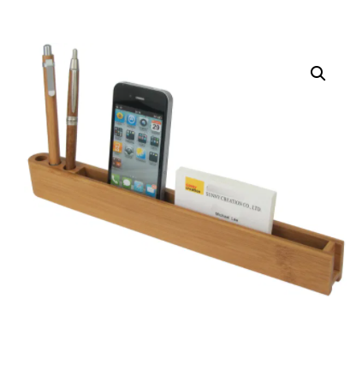
task
Using Morphological Analysis, design at least 3 ideas for a desk tidy or desk organiser.
Your design must follow your given topics from the Morphological Analysis. You can also use the thought showers and inspiration boards to support your design(s).
Things you might want to include:
  What does it store and what goes where?
  What colours are you using?
  Where have you taken your inspiration from?
  What material(s) are you using?
  How would you manufacture this design?

Slide 17
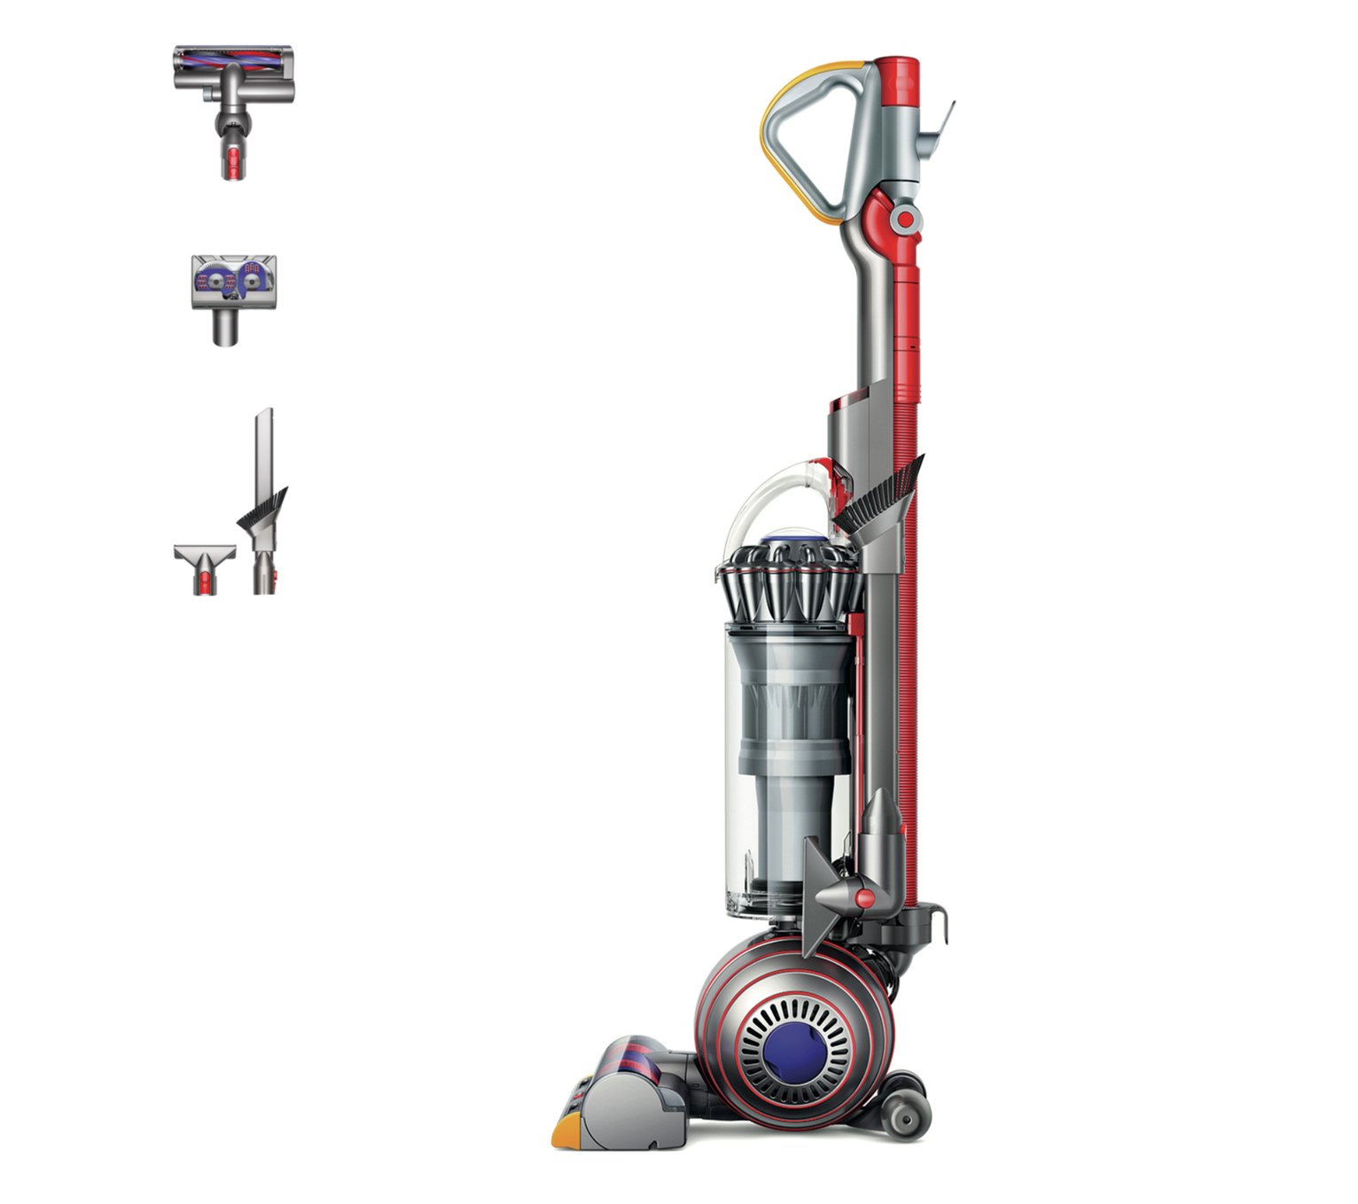
Nat 5 reminders-
Technology transfer
Technology transfer is a process by which the designer will make an association with technology, manufacturing processes or the chosen materials, and use this to provide a new idea or solution to another design.
Example
James Dyson used the technology of an industrial cyclone separator to come up with the design of his famous vacuum cleaners.
This is an example of how existing technology or ideas which already exist can be transferred and used in the design of a new product or invention entirely.

Slide 18
Nat 5 reminders-
Technology transfer
Technology transfer is a process by which the designer will make an association with technology, manufacturing processes or the chosen materials, and use this to provide a new idea or solution to another design.
Example
James Dyson used the technology of an industrial cyclone separator to come up with the design of his famous vacuum cleaners.
This is an example of how existing technology or ideas which already exist can be transferred and used in the design of a new product or invention entirely.

Slide 19
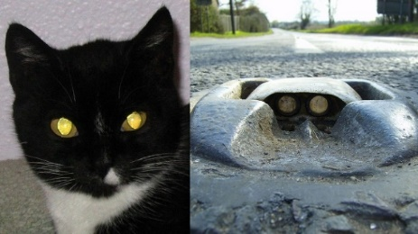
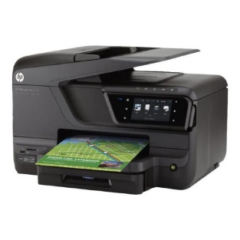
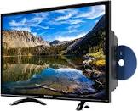
Technology transfer
Other Methods of Technology Transfer
Combination: When technology is combined to create a new product. For example, all-in-one printer and scanner, Built-in DVD TV sets etc.
Nature (see Analogy/Biomimicry): nature can provide inspiration for new products to help improve our lives. For example, cats’ eyes reflecting light is used to provide a method of signifying the centre of roads where there is no street lighting.
Task
Can you think of any other examples of technology transfer?
Research existing technology and try to use a combination or inspiration from existing technology to come up with a new idea or product.

Slide 20
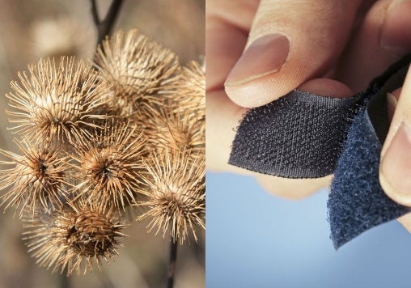
Analogy/
Biomimicry
Analogy is a comparison between two things. A designer can use analogies to generate unusual ideas by finding connections between their design problem and other products or the environment around them.
Biomimicry is a type of analogy that uses nature as the inspiration. In addition to cats’ eyes, Velcro is an example of a product mimicking nature: the burdock plant has burrs (small hooks) on the surface of its seeds. In nature, these hooks are used to disperse seeds as they catch onto an animal’s fur and later fall off in a new location.
Right: an example of how the shape of a light shade can be inspired by the eyelid of a frog, considering shape, form, pattern and movement in the design.

Slide 21
Taking your pencil for a walk
You may have done this in S1… Your teacher may do an example in the white space below.

